Slide 1
Graphical model of covid-19 transmission and protective behaviours
Susan Michie
Robert West
Matthew West
University College London
March 2020

Slide 2
Background and aims
Accurate mental models can play an important role in motivating health protective behaviour
They provide a reason why it is important to enact the behaviour and information about how best to do it
We aimed to devise a model of the spread of the covid-19 virus that could be presented to the public to help them understand the protective measures that are being proposed

Slide 3
Methods
We reviewed the advice being given by relevant authorities on behaviours to prevent the spread of the covid-19 virus and the justification used for this advice.
We developed a graphical model to show the transmission pathway and where in that pathway each of the behaviours was considered to act.
We revised the representation iteratively until we judged that it was accurate from a clinical perspective

Slide 4
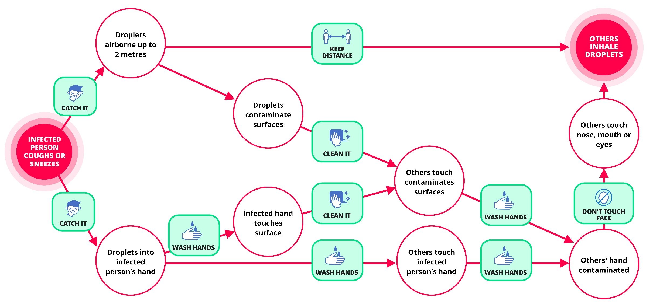
Resulting model

Slide 5
Comment
It would be useful to test the graphical model to assess the ability of people to interpret it and how far it may motivate them to enact the protective behaviours being proposed.

